Slide 1
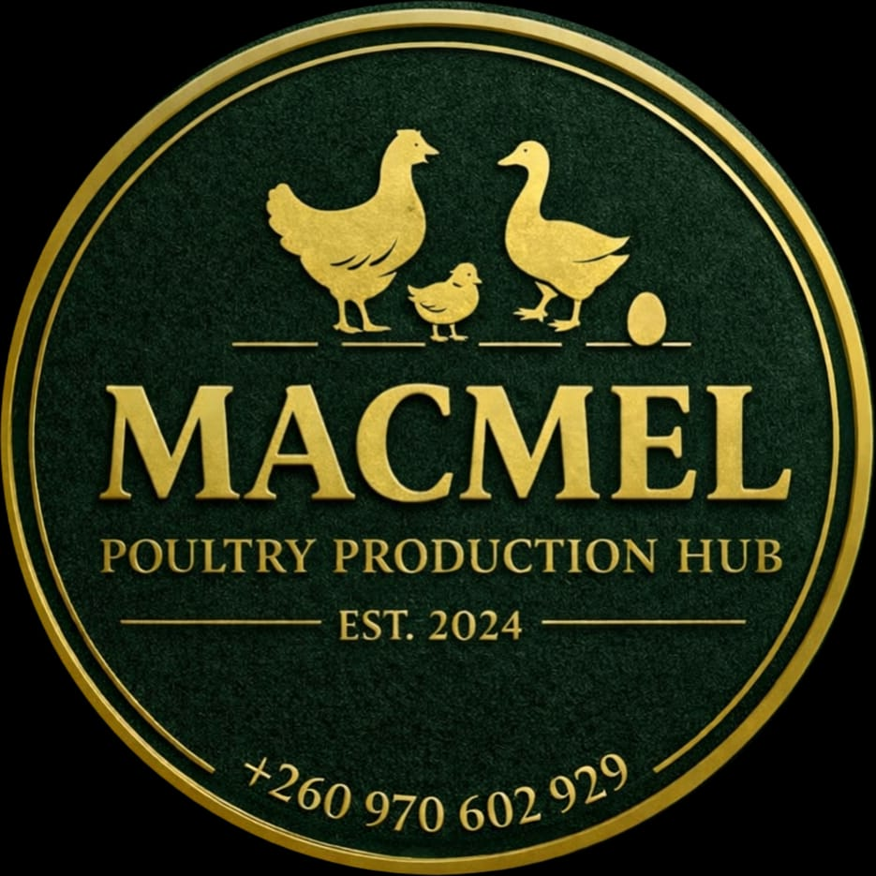
MACMEL POULTRY PRODUCTION HUB
COMPANY PROFILE

Slide 2
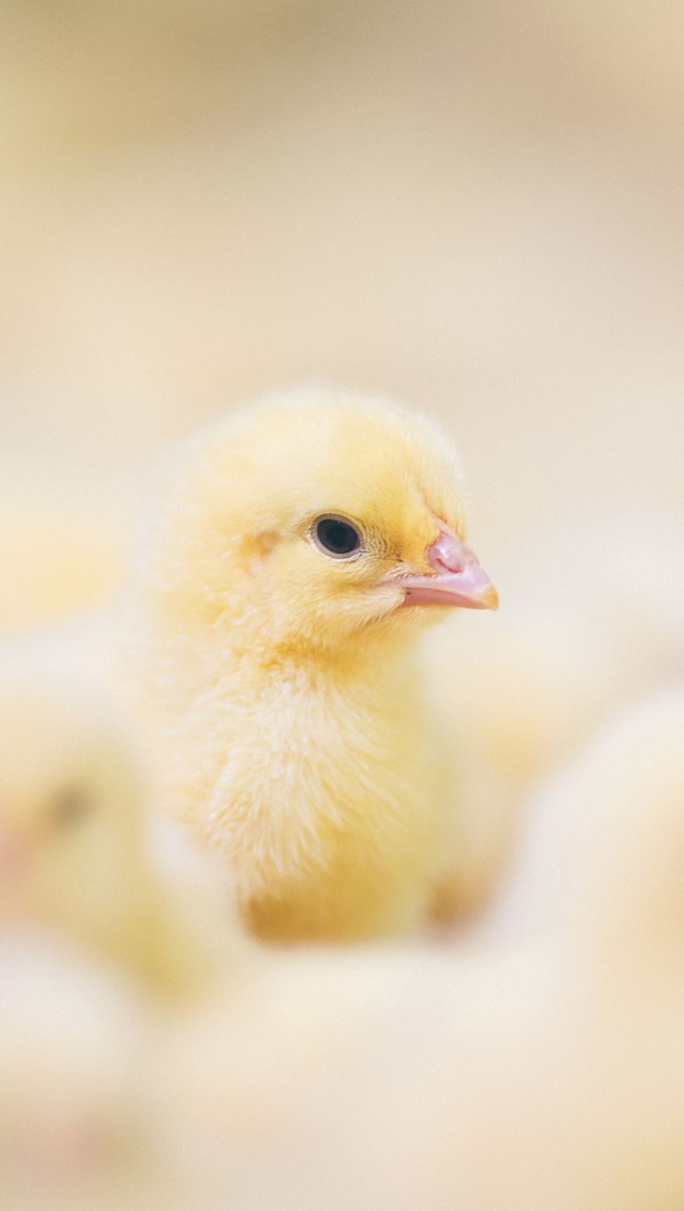
About Us
Macmel Poultry Production Hub is a sustainable and continually improving specialty poultry production business. Founded in 2024 in Chililabombwe, Zambia, we focus on breeding, rearing, and supplying premium heritage and high-performance poultry breeds.
We are committed to high standards of animal welfare, biosecurity, and environmental sustainability while delivering healthy, productive birds and fertilized eggs to farmers, households, and commercial clients.

Slide 3
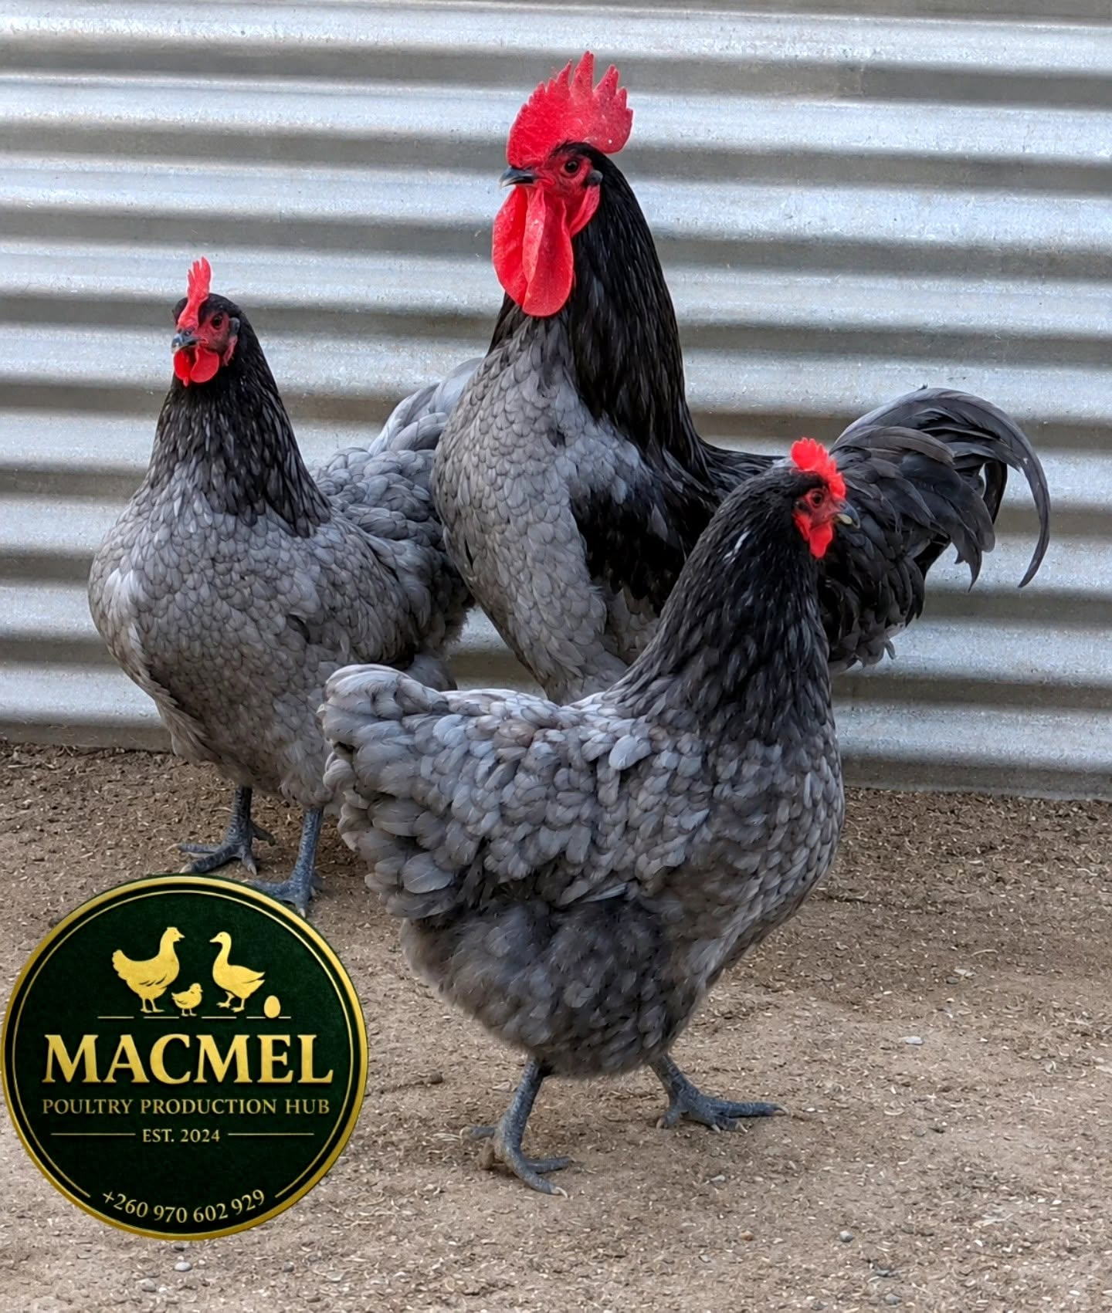
Our Mission
Our mission at Macmel Poultry Production Hub is to provide superior quality specialty poultry and fertilized eggs driven by integrity, innovation, and a strong commitment to animal welfare and sustainability.
We strive to supply healthy, high-performing birds that meet the specific needs of Zambian farmers and consumers.
Our goal is to give you peace of mind by:
Operating as a sustainable and environmentally conscious farm
Maintaining a focused range of premium specialty poultry
Offering expert guidance on breed selection, rearing, and management
Delivering consistent quality and reliable supply
Building a dedicated and professional team
Providing excellent customer service and after-sales support

Slide 4
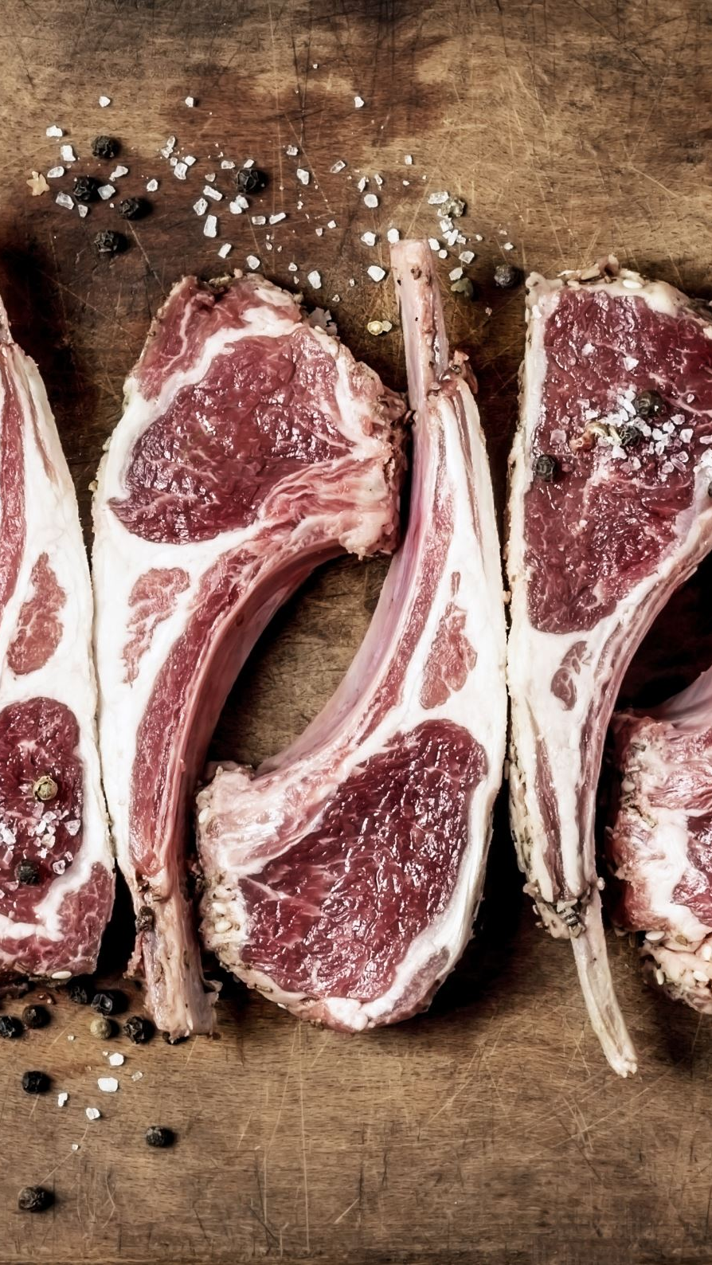
Our Vision
We aim to be the leading butchery suppliers of 100% natural meat and meat products in Zambia. Our vision is to consistently exceed customer expectations in quality, freshness, reliability, and service while promoting sustainable farming practices, animal welfare, and contributing to local food security and agricultural development.

Slide 5
Our Specialty Breeds & Products
Fertilized Eggs — High-quality fertilized eggs from all the above breeds, suitable for hatching or consumption.

Slide 6
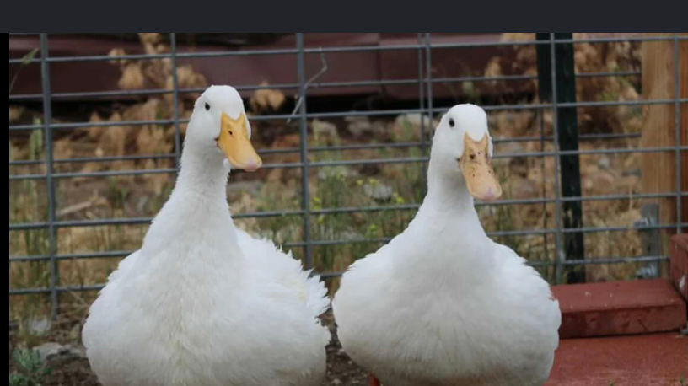
Our Specialty Breeds & Products
We specialize in the following high-quality poultry

Slide 7
Black Australorps
Beautiful jet-black feathered chickens renowned as exceptional egg layers (up to 300+ eggs per year), with a docile temperament and strong foraging ability. Highly adaptable to Zambian conditions.

Slide 8
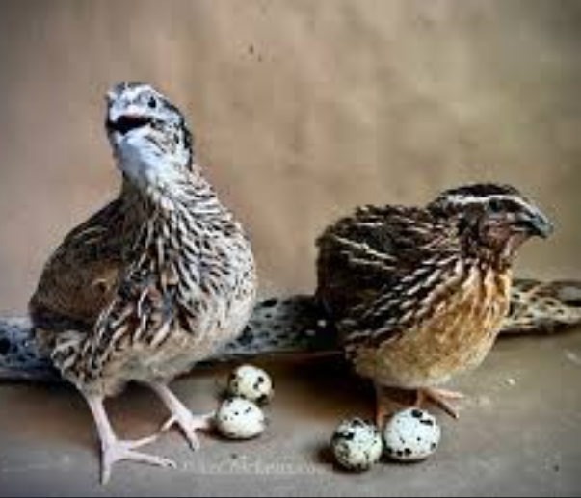
Jumbo Quails
Fast-maturing, high-yield quails prized for their delicate, flavorful meat and nutrient-rich eggs. Excellent for small-scale and commercial production due to their short production cycle and high profitability.

Slide 9
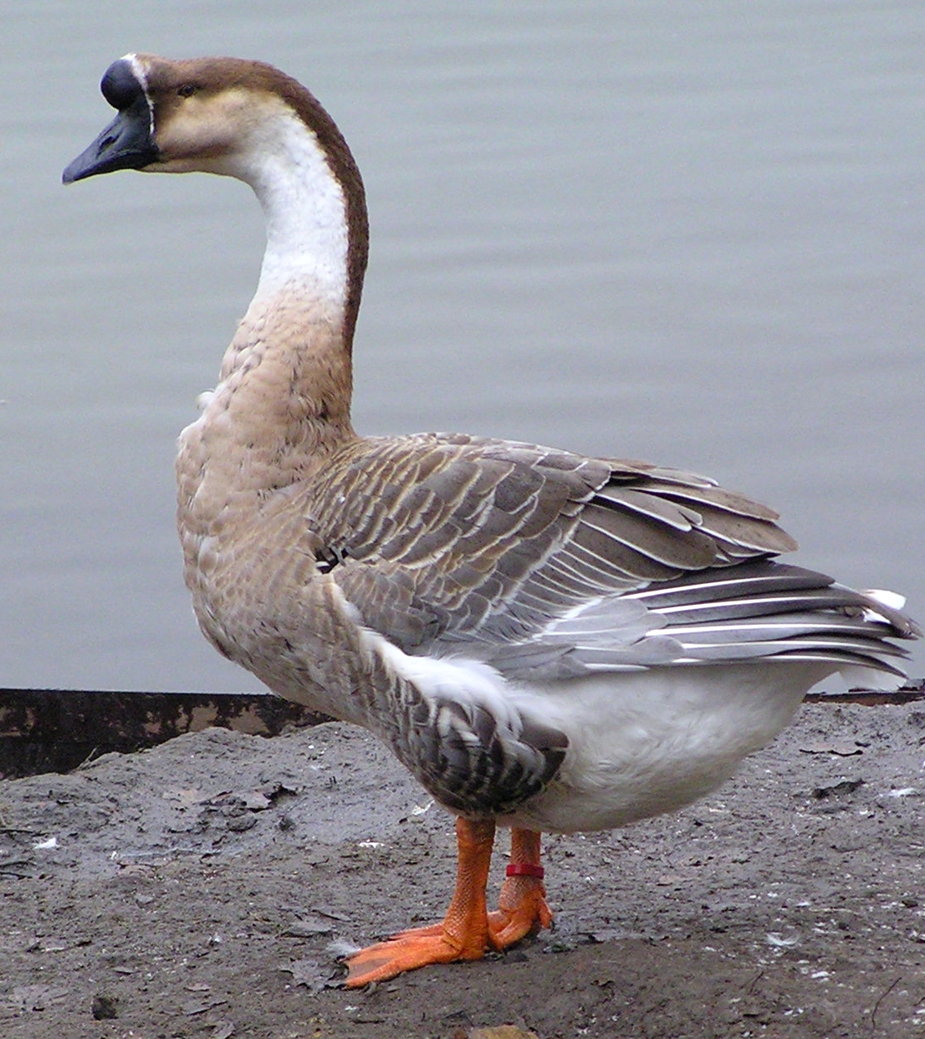
Chinese Geese
Large, hardy geese with excellent foraging ability, ideal for meat production and natural weed/pest control. They are good watch animals and produce rich meat with a unique flavor.

Slide 10
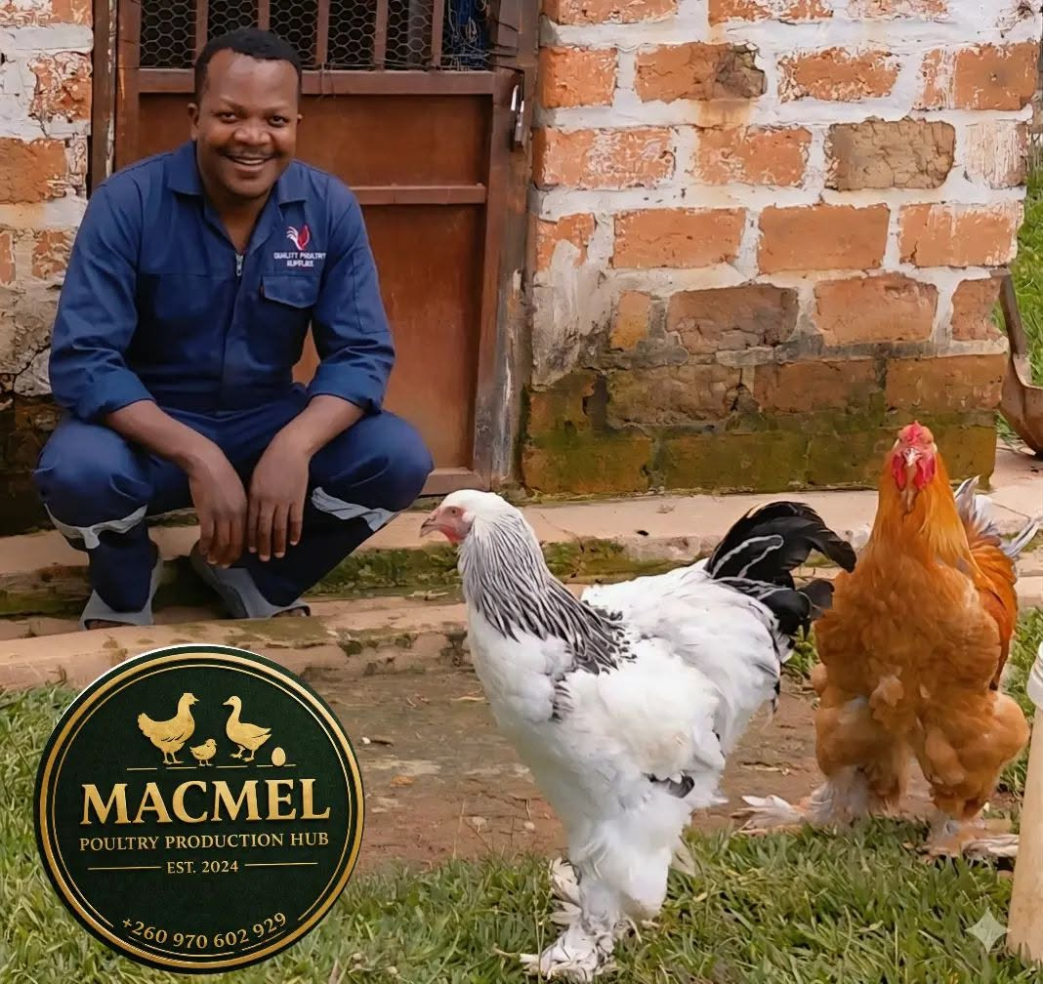
Brahma Chickens
Large, gentle “gentle giants” with feathered legs and striking appearance. Excellent dual-purpose breed providing substantial meat and good egg production. Very calm and cold-hardy.

Slide 11
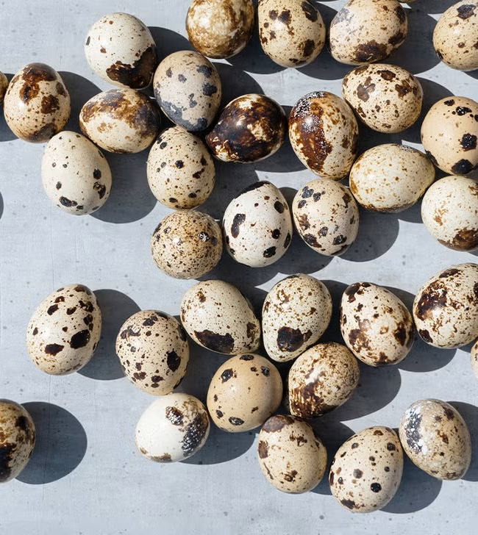
Fertilized Eggs
High-quality fertilized eggs from all the above breeds, suitable for hatching or consumption

Slide 12
Why Choose Macmel?
Breed Purity & Quality — Carefully selected and maintained genetics for optimal meat yield and taste
100% Natural Meat — No hormones or unnecessary antibiotics — naturally raised birds
Health Guarantee — Strict biosecurity, vaccination, and disease prevention protocols
Expert Advice — Detailed guidance tailored to each breed (housing, feeding, health management)
Sustainability — Emphasis on free-range and semi-intensive systems with eco-friendly practices
Reliable Supply — Consistent availability from our hub in Chililabombwe to butcheries and markets
Our Portfolio

Slide 13
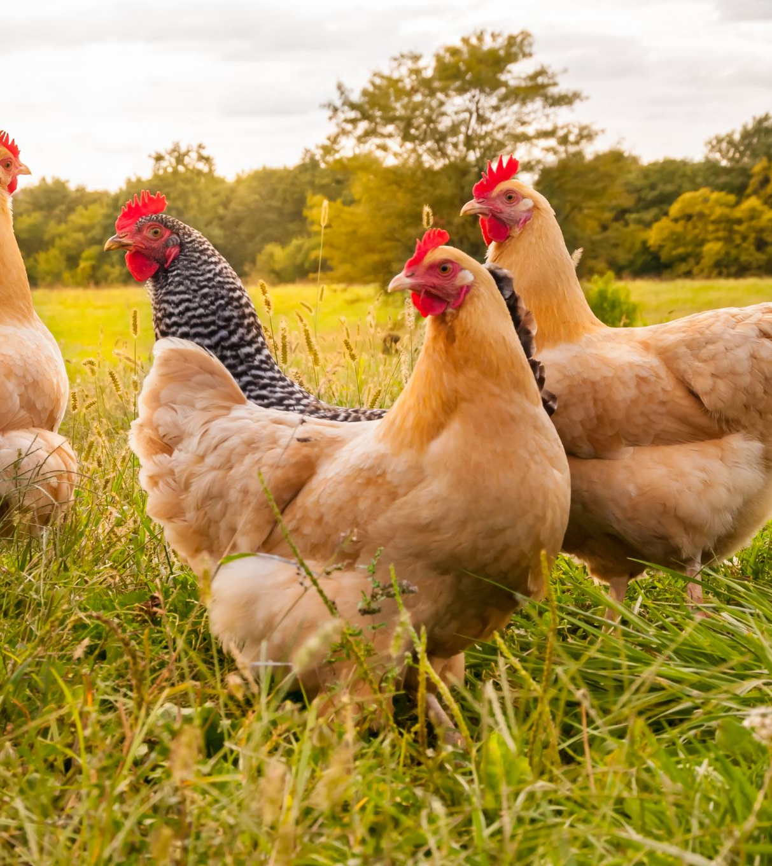
Our Portfolio
Since 2024, Macmel Poultry Production Hub has successfully supplied healthy Pekin Ducks, Jumbo Quails, Black Australorps, Chinese Geese, and Brahma Chickens to farmers, butcheries, and projects across Chililabombwe and the Copperbelt region. We continue to expand our breeding stock and incubation capacity to meet the growing demand for 100% natural specialty poultry meat.

Slide 14
The Team
Our experienced team brings together expertise in specialty poultry breeding, husbandry, incubation, and customer support. We are passionate about raising healthy, productive birds and helping our customers succeed.

Slide 15
Contact Us
Macmel Poultry Production Hub Chililabombwe, Zambia Phone: +260 970 602 929
We can’t wait to get started!
Contact us today for high-quality Pekin Ducks, Jumbo Quails, Black Australorps, Chinese Geese, Brahma Chickens, and 100% natural meat supply.
Macmel Poultry Production Hub — Quality. Heritage. Sustainability.

